Slide 1

Final project
Statistical programing in R

Slide 2
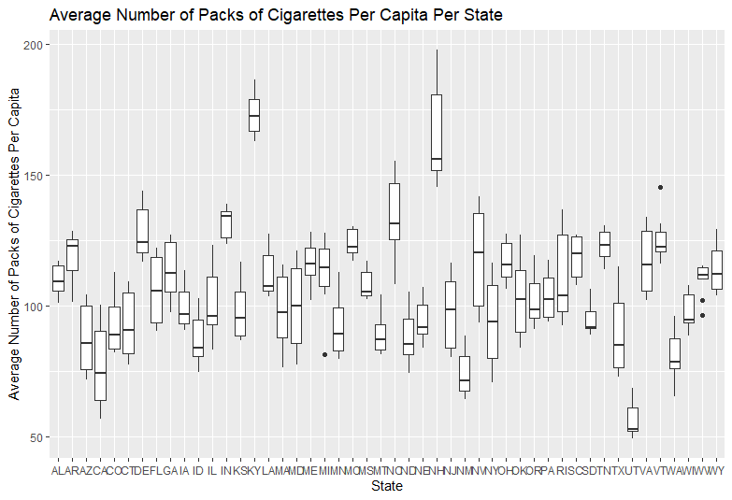
Analysis: From this chart, you can see that the state with the highest average number of packs per capita is New Hampshire and the lowest is Utah.
Code used to produce this chart:
ggplot(Cigarette, aes(x= state, y= packpc)) + geom_boxplot() + ggtitle("Average Number of Packs of Cigarettes Per Capita Per State") + xlab("State") + ylab("Average Number of Packs of Cigarettes Per Capita")

Slide 3
Analysis: This data shows that as the years progressed, the median number of packs per capita decreased.
Year | Median Number of Packs Per Capita
1985 | 118.58
1986 | 166.20
1987 | 113.17
1988 | 111.38
1989 | 108.16
1990 | 100.30
1991 | 97.89
1992 | 95.07
1993 | 93.19
1994 | 92.79
1995 | 92.83
Code used:
library(dplyr)
median <- Cigarette %>% select(year, state, packpc) %>% group_by(year) %>% summarise(medianCIG <- median(packpc))

Slide 4
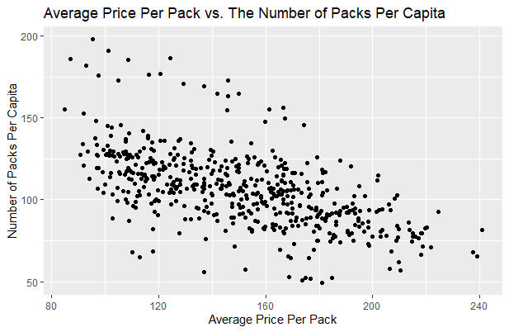
From the scatter plot above, I can assume that the average price per pack and the number of packs for capita has a moderately negative correlation.
Code Used:
c <- ggplot(Cigarette, aes(x= avgprs, y= packpc))
c + geom_point() + ggtitle("Average Price Per Pack vs. The Number of Packs Per Capita") + xlab("Average Price Per Pack") + ylab("Number of Packs Per Capita")

Slide 5
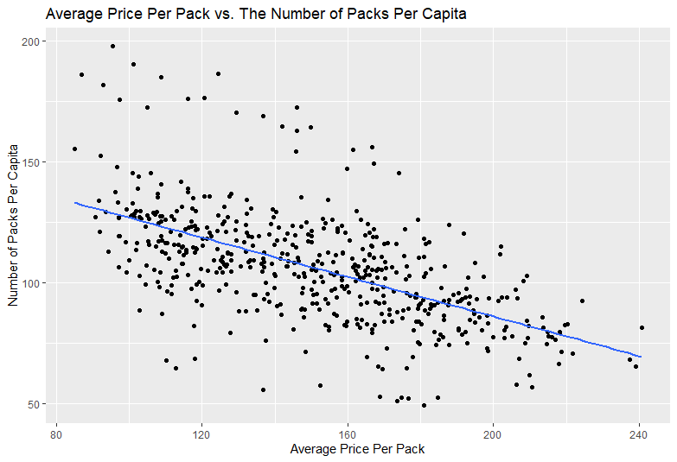
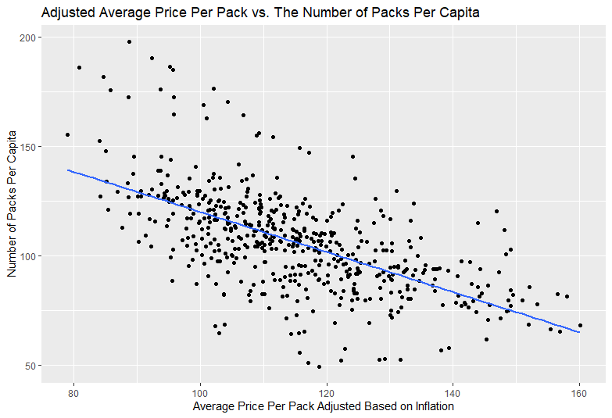
Below you can see a side-by-side view of the average price per pack vs. the number of packs per capita for all states and years. The scatter plot on the left shows the average price, whereas the chart on the left shows the price adjusted for inflation. The chart shows that it is negatively correlated. This is expected because as the price per pack increases, the number of packs per capita declines meaning less people went out and purchased it at the higher price.
c <- ggplot(Cigarette, aes(x= avgprs, y= packpc))
c + geom_point() + geom_smooth(method= lm, se= FALSE) + ggtitle("Average Price Per Pack vs. The Number of Packs Per Capita") + xlab("Average Price Per Pack") + ylab("Number of Packs Per Capita")
mutate(Cigarette, Adj_price = avgprs/cpi) -> Cigarettew_adj
c <- ggplot(Cigarettew_adj, aes(x= Adj_price, y= packpc))
c + geom_point() + geom_smooth(method= lm, se= FALSE) + ggtitle("Adjusted Average Price Per Pack vs. The Number of Packs Per Capita") + xlab("Average Price Per Pack Adjusted Based on Inflation") + ylab("Number of Packs Per Capita")

Slide 6
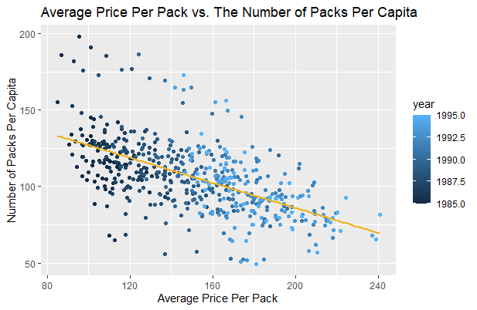
To get a better look, we added another factor to compare the data to, which is the years. As you can see from the chart, the price went up over the years, which might have resulted in decreased number of packs per capita over time. There could have been other factors that lead to the decline, but the chart shows that this is one possible factor.
Code Used:
c <- ggplot(Cigarette, aes(x= avgprs, y= packpc, color= year))
c + geom_point() + geom_smooth(method= lm, se= FALSE, color= "goldenrod2") + ggtitle("Average Price Per Pack vs. The Number of Packs Per Capita") + xlab("Average Price Per Pack") + ylab("Number of Packs Per Capita")

Slide 7
T-test analysis
We preformed a t-test analysis to see if the number of packs per capita in 1995 was significantly different than the number of packs per capita in 1985.
Using the p-value (p-value < 2.2e-16), because it is smaller than 0.05, the number of packs per capita in 1985 vs. 1995 is significantly different.
Code Used:
Year_1985 <- Cigarettew_adj %>% filter(year == 1985) %>% select(state, year, packpc)
Year_1995 <- filter(Cigarette, year == 1995) %>% select(state, year, packpc)
CigYear <- data.frame(Year_1985, Year_1995)
t.cig <- t.test(CigYear$packpc, CigYear$packpc.1, paired= TRUE)
t.cig
Paired t-test
data: CigYear$packpc and CigYear$packpc.1
t = 14.789, df = 47, p-value < 2.2e-16
alternative hypothesis: true difference in means is not equal to 0
95 percent confidence interval:
22.21151 29.20576
sample estimates:
mean of the differences
25.70863

Slide 8
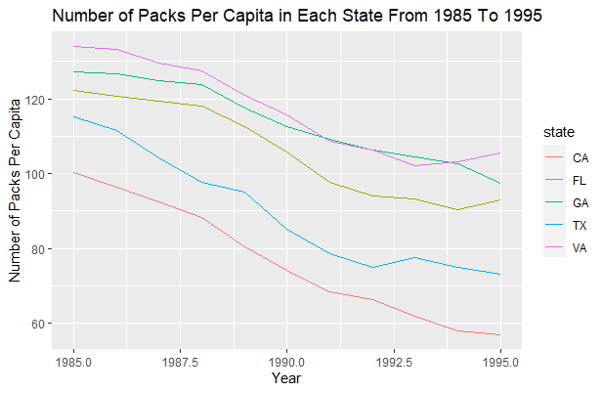
Personal analysis
In my own analysis, I wanted to see how many packs per capita over the years in specific states (CA, FL, GA, TX, VA). I added color to help distinguish the states from 1985 to 1995. I can see a decline in all states which is aligned with the results of the all states over the year. The most surprising part of this analysis is the number of packs per capita in California. It is the biggest state in this dataset and had the smallest number of packs per capita over the years.
Code Used:
r <- Cigarette %>% filter(state %in% c("VA", "GA", "TX", "FL", "CA")) %>% group_by(state) %>% select(year, state, income, packpc)
rh <- ggplot(r, aes(x= year, y= packpc, color= state))
rh + geom_line() + ggtitle("Number of Packs Per Capita in Each State From 1985 To 1995") + xlab("Year") + ylab("Number of Packs Per Capita")

